Slide 1

MISSED SALES FORECAST LAST 2 MONTHS
Valentín de la Rosa

Slide 2
AGENDA
Introduction
Data Overview
Hypothesis Formulation
Testing and Validation
Data improvements and Recommendations
Conclusion

Slide 3

1. PROBLEM INTRODUCTION

Slide 4
2. DATA OVERVIEW
Source: Website interactions and metadata
'Date’
'Product_ID’
'Product_Category’
'Clicks’
'Sales’
'Price’
'Customer_Age’
'Customer_Gender’
'Region’
'Click_Count’
'Wait_Time’
'Browser

Slide 5
2. DATA OVERVIEW
Some not very interesting insights

Slide 6
2. DATA OVERVIEW
Some VERY interesting insights

Slide 7
3. HYPOTHESES FORMULATION
NikeByYou Was recently updated and the performance of the 360 view works bad in chrome giving a very laggy experience, this could be having a great impact cause of the 15 seconds rule.
Last two months we were at Christmas and the sales should have been bigger
We could create better marketing strategies using Machine learning to equal the price of the Most sold: Nike Dunk Low Retro, nike dunk high, Air Max 90 GORE-TEX. These can’t be customized
Waitime between clicks

Slide 8
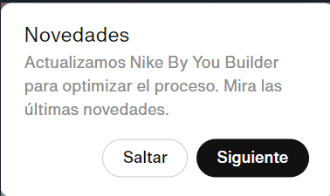
4. TESTING AND VALIDATION
NikeByYou Was recently updated

Slide 9
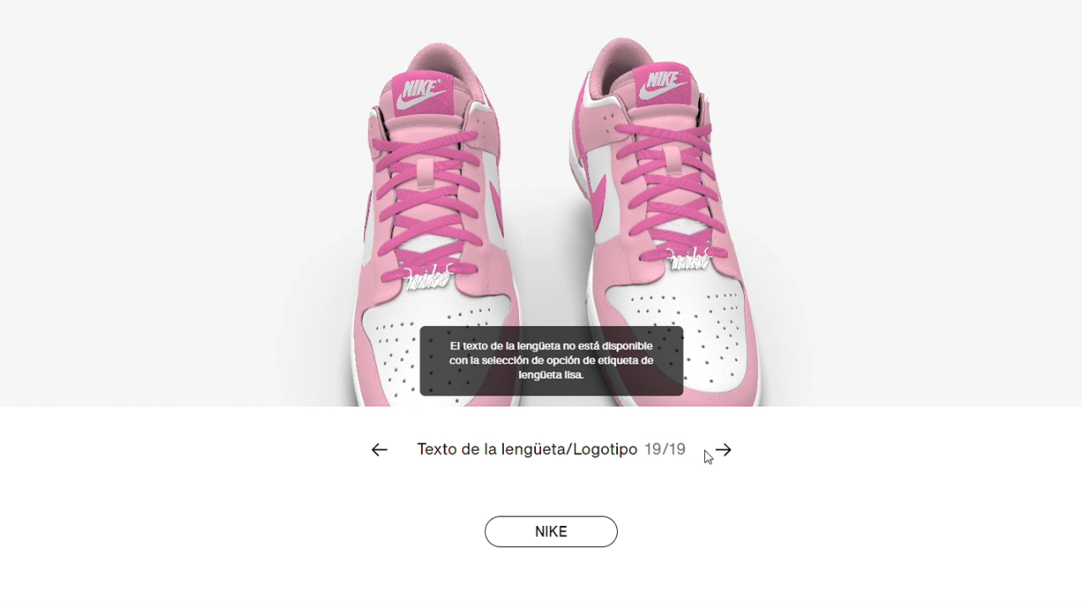
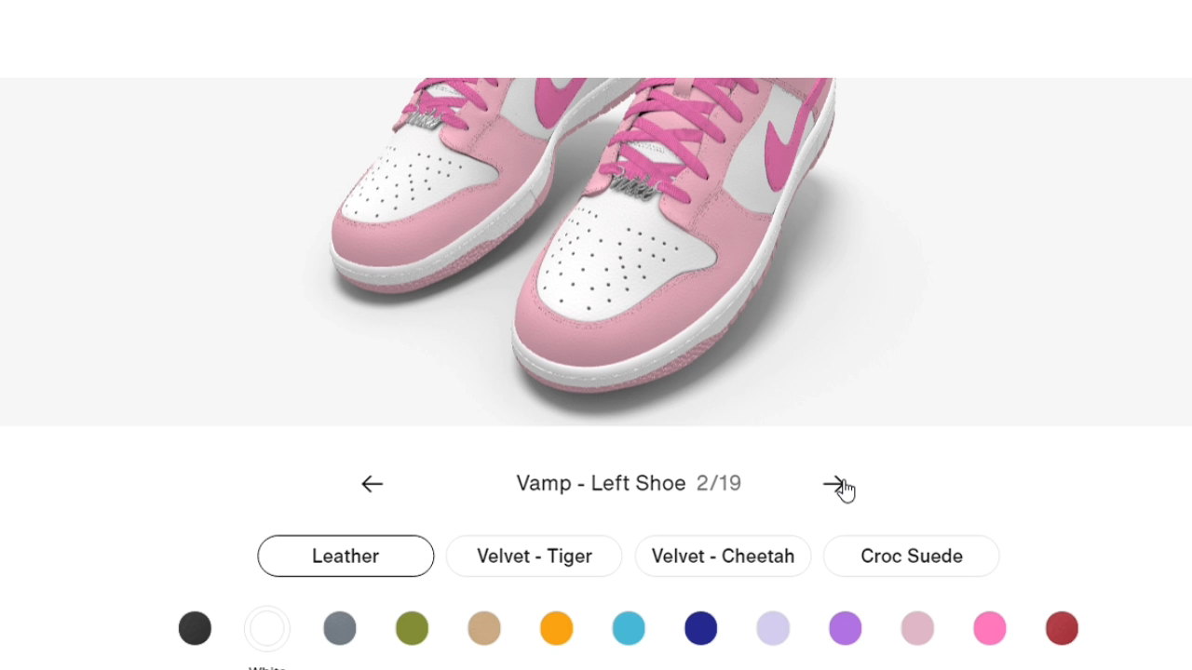
4. TESTING AND VALIDATION
performance of the 360 view works bad in chrome giving a very laggy experience, this could be having a great impact cause of the 15 seconds rule.
Edge
Chrome

Slide 10
4. TESTING AND VALIDATION
Waitime between interaction:
is know that the first 15 seconds that an user spends in a website determine if the users it's gonna stay or leave
Source: https://www.w3counter.com/globalstats.php
https://www.makerobos.com/topic/ask-an-expert/15-seconds-rule-to- engage-website-visitors

Slide 11
4. TESTING AND VALIDATION
Most sold: Nike Dunk Low Retro, nike dunk high, Air Max 90 GORE-TEX are cheaper than the models with the "customize" options
last two months we were at Christmas and the sales should have been bigger

Slide 12
5. IMPROVEMENTS AND RECOMENDATIONS
Check the current forecast model to make sure the forecasting accuracy is good enough, check if it could be improved and check if it’s getting retrained with enough and updated data.
Improve the performance of Google Chrome browser and make sure that the shop site is properly working in all browsers and apps available
Implement machine learning models to assign profiles to users, making possible to send customized marketing sales and recommendations increasing the probability of converting and user into a buyer and getting new insights about customer behavior
Implement Cloud Computing functions to report the performance measure of the app and some traffic information
Create a Recommendations engine, combining it with previous ML model to try to catch buyers after the Christmas shopping using the Nike Official marketing strategies combined with ML recommendations, if they checked the website in Christmas and didn’t buy anything they could be a potential buyer

Slide 13
DATA ANALYSIS AND GENERATION
In case you want to check how the synth data was generated and how the data analysis was made, you can check it here:
https://github.com/ValentinDeLaRosa/kin-carta_Challenge Data analysis file: Analysis.ipynb Data Generation file: Data generator.py

Slide 14
THANK
YOU

